Slide 1
Chapter 1: Introduction
Lecture 4
Week 2
Ms. Nazia Shahzadi

Slide 2
Chapter 1: Introduction
Operating-System Operations
Process Management
Memory Management
Storage Management
Protection and Security
Kernel Data Structures
Computing Environments
Open-Source Operating Systems

Slide 3
Objectives
To describe the basic organization of computer systems
To provide a grand tour of the major components of operating systems
To give an overview of the many types of computing environments
To explore several open-source operating systems

Slide 4

Computer System Organization
Computer-system operation
  One or more CPUs, device controllers connect through common bus providing access to shared memory
  Concurrent execution of CPUs and devices competing for memory cycles

Slide 5
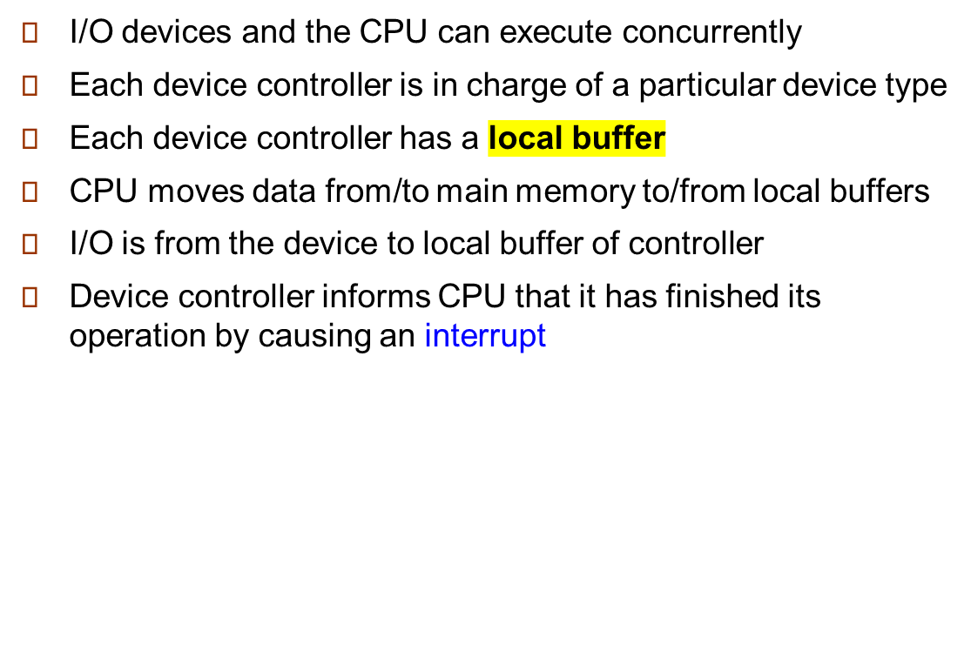
Computer-System Operation

Slide 6
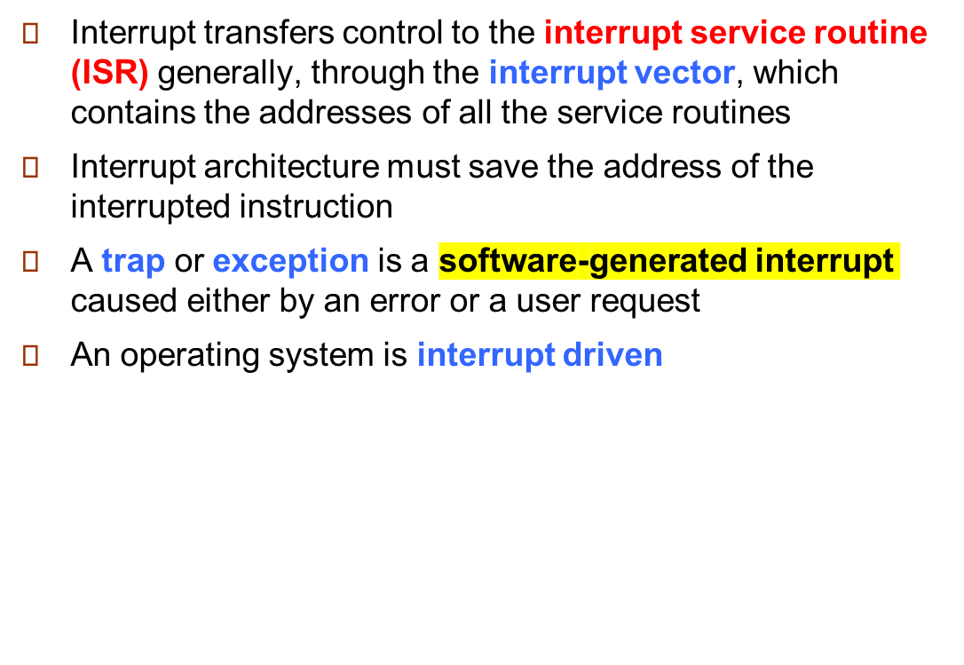
Common Functions of Interrupts

Slide 7
Interrupt Handling
The operating system preserves the state of the CPU by storing registers and the program counter
Determines which type of interrupt has occurred:
  polling
  vectored interrupt system
Separate segments of code determine what action should be taken for each type of interrupt

Slide 8

Interrupt Timeline

Slide 9
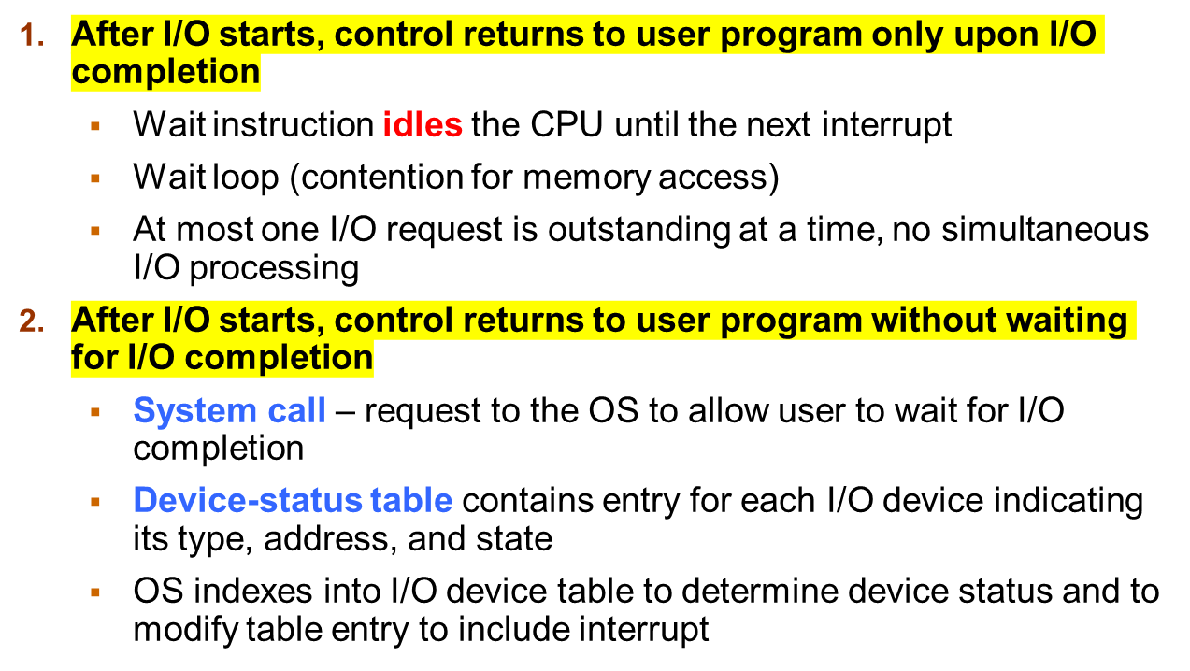
I/O Structure (Two Possibilities)

Slide 10
Storage Definitions and Notation Review
The basic unit of computer storage is the bit. A bit can contain one of two values, 0 and 1. All other storage in a computer is based on collections of bits. Given enough bits, it is amazing how many things a computer can represent: numbers, letters, images, movies, sounds, documents, and programs, to name a few. A byte is 8 bits, and on most computers it is the smallest convenient chunk of storage. For example, most computers don’t have an instruction to move a bit but do have one to move a byte. A less common term is word, which is a given computer architecture’s native unit of data. A word is made up of one or more bytes. For example, a computer that has 64-bit registers and 64-bit memory addressing typically has 64-bit (8-byte) words. A computer executes many operations in its native word size rather than a byte at a time.
Computer storage, along with most computer throughput, is generally measured and manipulated in bytes and collections of bytes.
A kilobyte, or KB, is 1,024 bytes
a megabyte, or MB, is 1,024² bytes
a gigabyte, or GB, is 1,024³ bytes
a terabyte, or TB, is 1,024⁴ bytes
a petabyte, or PB, is 1,024⁵ bytes
Computer manufacturers often round off these numbers and say that a megabyte is 1 million bytes and a gigabyte is 1 billion bytes. Networking measurements are an exception to this general rule; they are given in bits (because networks move data a bit at a time).

Slide 11
Storage Structure
Main memory – only large storage media that the CPU can access directly
  Random access
  Typically volatile
Secondary storage – an extension of main memory that provides large nonvolatile storage capacity
Hard disks – rigid metal or glass platters covered with magnetic recording material
  Disk surface is logically divided into tracks, which are subdivided into sectors
Solid-state disks – faster than hard disks, nonvolatile
  Various technologies
  Becoming more popular

Slide 12
Storage Hierarchy
Storage systems organized in hierarchy
  Speed
  Cost
  Volatility
Caching – copying information into faster storage system; main memory can be viewed as a cache for secondary storage
Device Driver for each device controller to manage I/O
  Provides uniform interface between controller and kernel

Slide 13
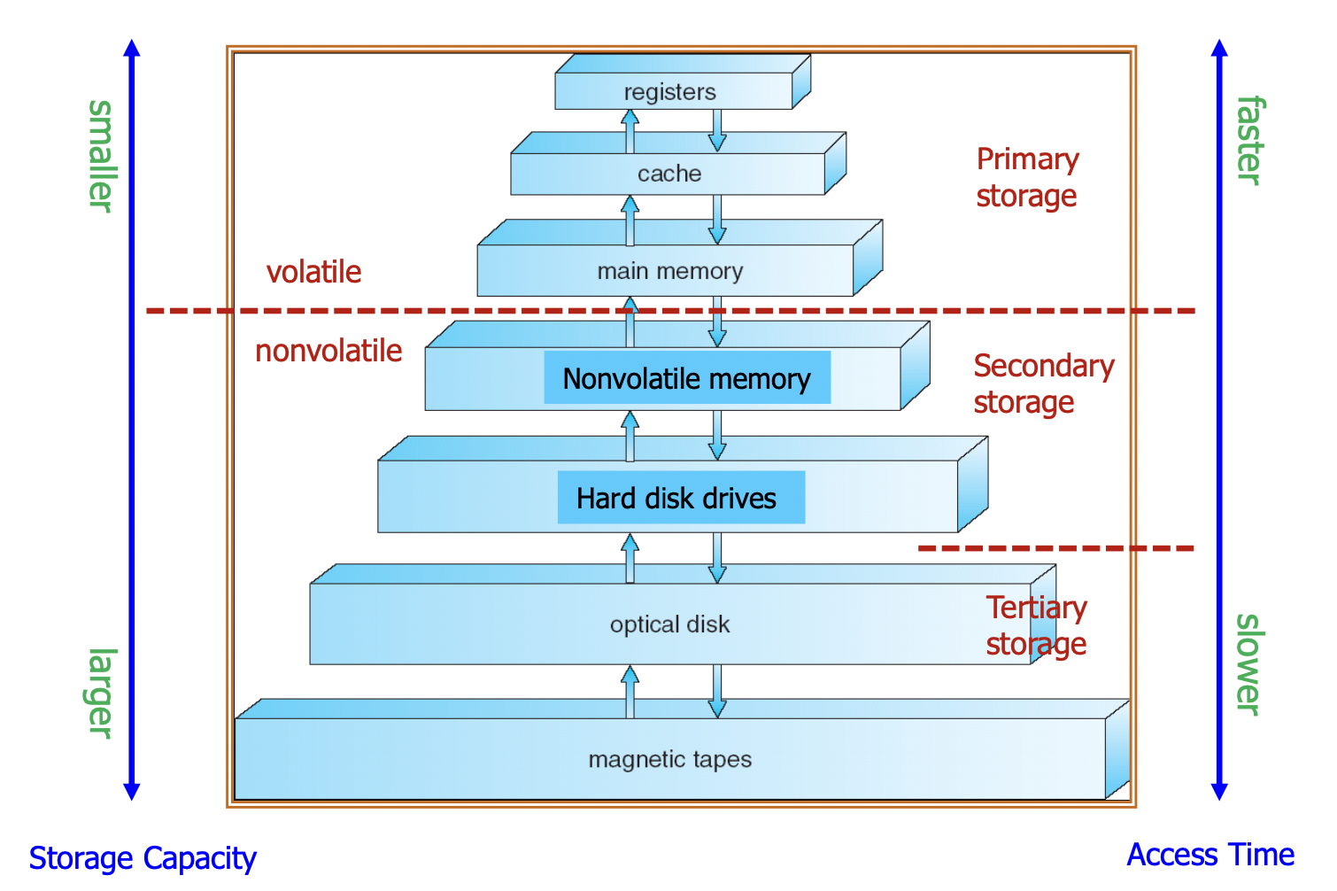
Storage-Device Hierarchy

Slide 14
End of Lecture 4

